Slide 1
CHAPTER 5:
Interaction Devices
Designing the User Interface:
Strategies for Effective Human-Computer Interaction
Fifth Edition
Ben Shneiderman & Catherine Plaisant
in collaboration with
Maxine S. Cohen and Steven M. Jacobs

Slide 2
Interaction Devices
Keyboard Layouts
Pointing devices
Novel devices
Speech & auditory interfaces
Displays
8-<number>

Slide 3
Speech and auditory interfaces
Speech recognition still a challenging one:
  demands of user's working memory
  background noise problematic
  variations in user speech performance impacts effectiveness
  most useful in specific applications, such as to benefit handicapped users
8-<number>

Slide 4
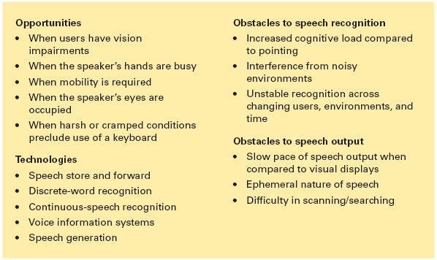
Speech and auditory interfaces (cont.)
8-<number>

Slide 5
Discrete word recognition
  Recognize individual words spoken by a specific person; can work with 90- to 98-percent reliability for 20 to 200 word vocabularies
  Speaker-dependent training, in which the user repeats the full vocabulary once or twice
  Speaker-independent systems are beginning to be reliable enough for certain commercial applications
8-<number>

Slide 6
Continuous-speech recognition
    Challenges:
    Difficulty in recognizing boundaries between spoken words
    Normal speech patterns blur boundaries
    Diverse accents
    Variable speaking rates
    Disruptive background noise
    Challenging emotional intonation
8-<number>

Slide 7
Continuous-speech recognition
    Applications of CSR systems:
    Enable users to dictate letters and compose reports verbally for automatic transcription.
    Enable automatic scanning and retrieval from radio or television programs, court proceedings, lectures, or telephone calls for specific words or topics.
    Examples:
    IBM ViaVoice® speech-dictation system
    Dragon® - NaturallySpeaking™ Medical system
8-<number>

Slide 8
Voice Information System
    Interactive Voice Response (IVR) – can provide good customer service at low cost.
    Voice Information technologies are used in Personal Voicemail systems.
    Telephone based speech systems enable storing and forwarding of spoken messages with user commands entered with keyboards. ( eg: Whatsapp)
    Small hand held voice note-takers available in the market.
    Audio books have been successful – allow users to control the pace, while conveying the curator’s enthusiasm or author’s emotions.
8-<number>

Slide 9
Speech generation
  Speech generation is a successful technology:
    Inexpensive, compact and reliable systems using digitized speech segments have been used in Automobile Navigation System, Internet services, Utility Control rooms and Children's games.
    Applications for Blind:
    Text-to-speech utilities like the built-in Microsoft Windows Narrator.
    Screen readers like Freedom Scientific’s JAWS – allows users with visual impairments to productively navigate between windows, select applications, browse graphical interfaces and read text
8-<number>

Slide 10
Speech Generation
Speech Synthesis:
Speech synthesis is technologically feasible. Algorithms are used to generate the sound (speech synthesis) and the intonation may sound robot-like and distracting.
The quality of the sound can be improved when phonemes, words, and phrases from digitized human speech can be smoothly integrated into meaningful sentences.
However, for some applications, a computer-like sound may be preferred. For example, the robot-like sounds used in the Atlanta airport subway drew more attention than did a tape recording of a human giving directions.
8-<number>

Slide 11
Speech Generation
Web-based voice applications:
Web-based voice applications are also seen as promising by many developers.
Standards for voice tagging of web pages (VoiceXML™and Speech Application Language Tags, or SALT) and improved software could enable several innovative applications.
For example, cell-phone users could access web information through combinations of visual displays and speech-generation output.
8-<number>

Slide 12
Displays – Small and Large
The display has become the primary source of feedback to the user from the computer
The display has many important characteristics, including:
    Physical dimensions (usually the diagonal dimension and depth)
    Resolution (the number of pixels available)
    Number of available colors, color correctness
    Luminance, contrast, and glare
    Power consumption
    Refresh rates (sufficient to allow animation and video)
    Cost
    Reliability
8-<number>

Slide 13
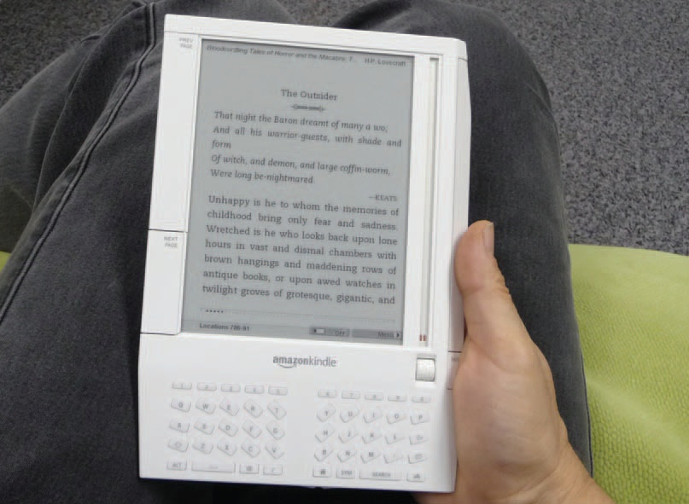
Displays – Small and Large (cont.)
Usage characteristics distinguish displays:
Portability
Privacy
Saliency
Ubiquity
Simultaneity
8-<number>

Slide 14
Display technology
Raster-scan cathode-ray tube (CRT)
  electron beam sweeping out lines of dots to form letters
  refresh rates 30 to 70 per second
Liquid-crystal displays (LCDs)
  voltage changes influence the polarization of tiny capsules of liquid crystals
  Thin film, light weight, low electricity consumption
Plasma Displays
  rows of horizontal wires are slightly separated from vertical wires by small glass-enclosed capsules of neon-based gases
  Flat profile, consume more electricity
8-<number>

Slide 15
Display technology (cont.)
Light-emitting diodes (LEDs)
  certain diodes emit light when a voltage is applied
  arrays of these small diodes can be assembled to display characters
  Used in large public displays, curved displays
  Matrices of some miniature LEDs are also used in some head-mounted displays.
  Organic Light-emitting diodes (OLEDs)
    Durable & energy efficient
    Laid on flexible plastic or metallic foil
    Used with wearable or rollable displays
8-<number>

Slide 16
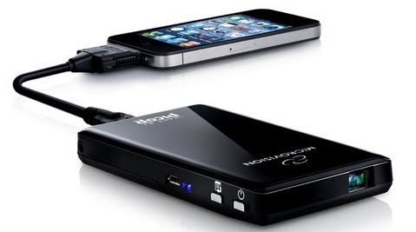
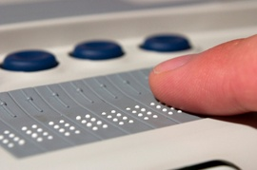
Display technology (cont.)
Electronic ink technology
  Paper-like resolution
  Tiny capsules with negatively charged black particles and positively charged white particles can be selectively made visible.
  Tiny Projectors – Microvision Pico projectors
  Project color images on the wall from mobile devices
Braille displays
  for the blind users
8-<number>

Slide 17
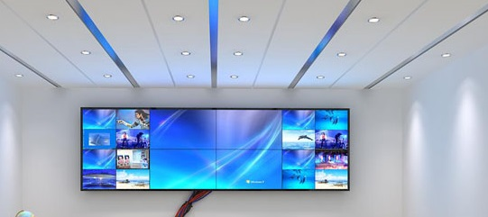
Large Displays
  Informational wall displays
  Interactive wall displays
  Multiple desktop displays
8-<number>

Slide 18
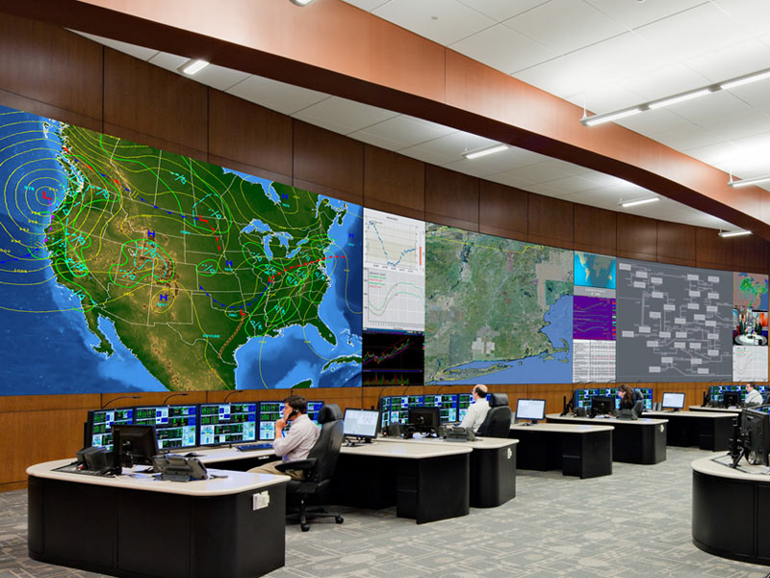
Large Displays
8-<number>

Slide 19
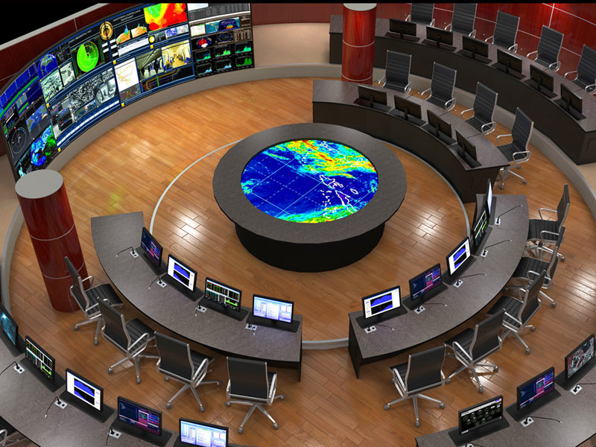
Large Informational Wall Displays
Effective in Control rooms
Details can be retrieved on individual consoles
Applications:
  Military command and control operations
  Utility Management
  Emergency response
  Allows teams of collaborating scientists and decision makers
8-<number>

Slide 20
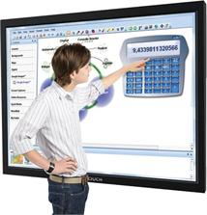
Interactive Wall Displays
Large touch sensitive screen on which a computer screen is projected
Digital white board System:
  SMART Board® from SMART technologies Inc.
  Colored pens and digital eraser simulate a traditional white board
  Facilitates Screen recording and software keyboard
8-<number>

Slide 21
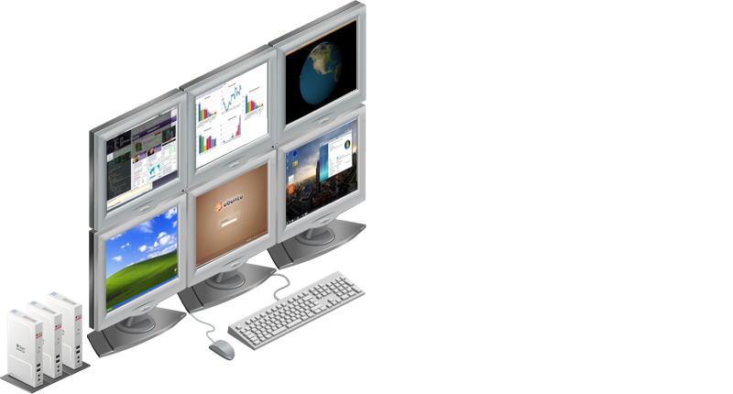
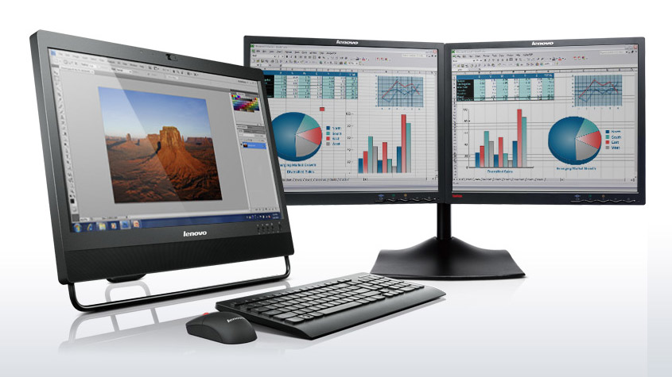
Multiple Desktop Displays
Discontinuities in the overall display space
Can be of different size and resolution
Users to stand or rotate their heads or bodies to attend all displays
Useful for personal creative applications
Example: Flash application might require a timeline, a stage, graphic component editors, a scripting language editor, a directory browser and a preview window, all open at the same time.
8-<number>

Slide 22
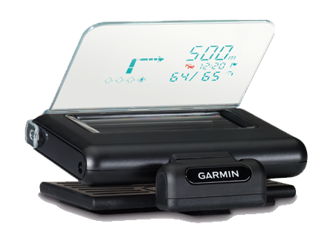
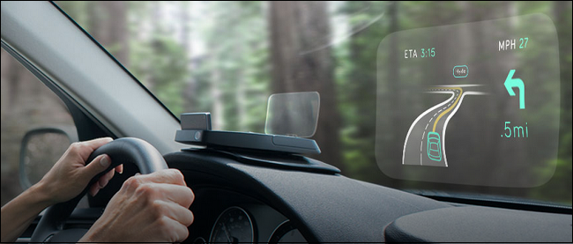
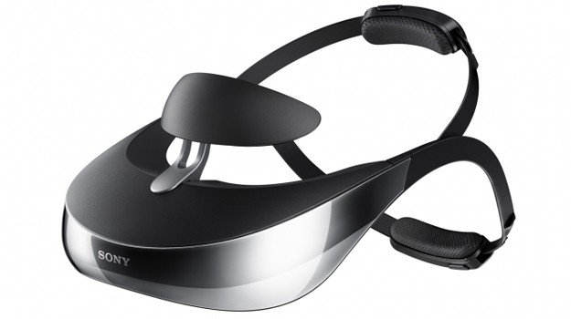
Heads-up and helmet mounted displays
  A heads-up display can, for instance, project information on a partially silvered widescreen of an airplane or car.
  A helmet/head mounted display (HMD) moves the image with the user.
  3D images
8-<number>

Slide 23
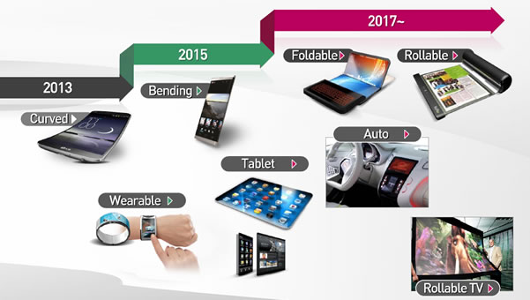
Mobile device displays
Currently mobile devices used for brief tasks, except for game playing
Optimize for repetitive tasks
Custom designs to take advantage of every pixel
DataLens allows compact overviews
Web browsing difficult
Okay for linear reading, but making comparisons can be difficult
8-<number>

